Slide 1
Ethical Hacking Term Project
By Vongai Kwenda
2024

Slide 2
Report Overview
The environment
Methodology
Metrics

Slide 3
Environment
Programming languages:
Python 3.x
Hashlib (python module)
IDE:
PyCharm Community Edition 2022.3.1
Third-party libraries:
PyCryptodome
Operating system: Windows 10

Slide 4
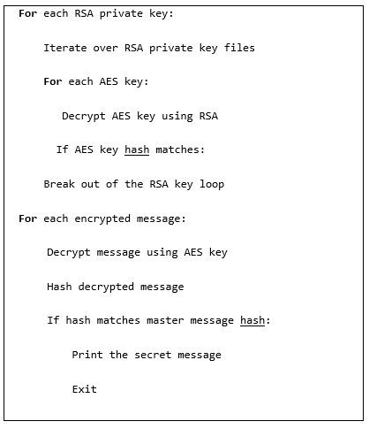
Methodology
Plan:
Decrypt AES Keys:
Use each RSA private key to decrypt the corresponding AES key. Compare AES hashes with plain_aes_hash.md5.
Decrypt Messages:
Use correct AES to decrypt all the messages Compare each message hash with the plain_master_message_hash.md5.
The plaintext secret message that matches the hash is the final answer.

Slide 5
Metrics
Content of dataset | Execution time lapse | Secret Message
1. RSA - 200 public keys and 200 private keys .pem files | 16:19:56 | why do kamikaze pilots wore helmets!!!!!!!!!!!!!!!!!!!!!!!!!!!!!
2. messages - 90001 message .emsg files
3. hashes - 2 plain_master_message_hash.md5 & plain_aes_hash.md5 hash files
4. AES - 200 session key files .eaes

Slide 6

Thank you!

